Slide 1

NETFLIX DATA ANALYSIS USING POWERBI

Slide 2
Problem Statement:
Analyze Netflix's content and customer viewing behavior to derive meaningful business insights. The goal is to clean and visualize the data to understand customer engagement, content popularity, and subscription trends.

Slide 3
Data Cleaning & Transformation
In excel, missing values in director column were filled with "Unknown".
The column date_added was standardized to Short Date format.
The outliers were checked to remove unrealistic values.
Prepared a clean, consistent, and analysis-ready dataset for visualization in Power BI.

Slide 4
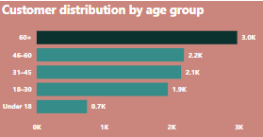
Customer Demographics Analysis
Insights: We have identified that age group 60+ are watching Netflix the most which indicates that older customers may prefer content such as Action, documentaries, and family-friendly TV shows.
Recommendation:
We need to concentrate on younger adults particularly, these 19-45 Age group are typically the working professionals who may use Netflix to relax after work. Content geared toward them could include workplace dramas, true crime series.

Slide 5
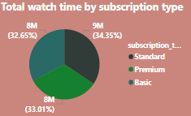
Subscription Type vs. Watch Time
Insights: Upon analyzing the relationship between watch time and subscription tier of customer that standard subscription tier has the highest engagement. High total watch time for standard users may point to high customer satisfaction with the features of this tier
Recommendation:
We have to improve engagement of premium tier which means Standard users are already highly engaged, this group is a prime target for upselling to the Premium plan. We can Consider offering exclusive content, special promotions, or temporary upgrades to encourage them to move to the Premium tier.

Slide 6
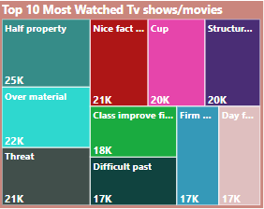
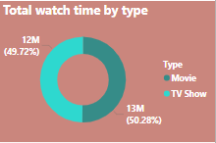
Descriptive & Comparative Analysis
Insights: Identified the top list are the highest-rated content that customers are consuming the most. The Top 10 list can reveal trends in user preferences, for instance, whether users tend to prefer certain genres
The watch time between Movies and TV Shows is equal, implies that different types of users have different viewing habits.
Recommendation:
By analyzing the both we got know the customer preference If certain shows/movies have a higher watch time among Premium subscribers, Netflix could promote exclusive content or feature similar shows for Standard users to encourage upgrades.

Slide 7
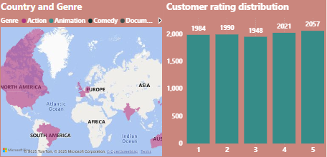
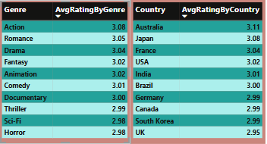
Genre Popularity by Country & Customer Ratings Distribution:
Action is the most popular genre per country based on the total number of viewers and received the highest average ratings, suggesting strong viewer engagement.
Australia and Japan showed higher average ratings, indicating strong content relevance or satisfaction in those regions.
Recommendation:
We can Implement optional surveys after 1–2 star ratings to understand dissatisfaction and guide improvements.

Slide 8
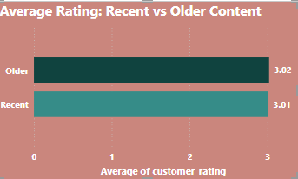
Trending Content Analysis:
This chart shows that older content (added before the last 2 years) has a slightly higher average rating (3.02) than recent content (3.01).
The difference is minimal but suggests that older titles may be more consistently well-received.
Recommendation:
Since older content performs slightly better and likely has better reviews. Netflix can re-promote some of the movies/shows.

Slide 9
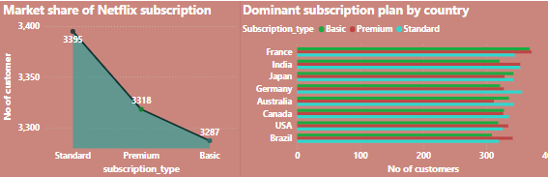
Market Insights & Revenue Analysis
Standard plan accounts for the largest share of Netflix subscriptions globally. This study suggests most users prefer cost-effective plans, possibly due to lower content consumption needs or price sensitivity.
Recommendation:
Run free trial offers or highlight exclusive benefits to attract more Premium users.

Slide 10
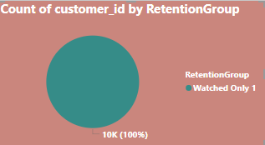
Customer Retention Insights
After analyzing the dataset, most customers appear to have watched only one show (one entry per customer).This suggests that customer engagement is low users may try the service but not continue watching more content.
Recommendation:
Focus on retaining high watch-time users by offering Premium content, early access, or loyalty programs.

Slide 11

High-Rated vs. Low-Rated Content:
Highest Rated Genres : Action, Romance, and Drama consistently receive the highest average customer ratings.
Lowest Rated Genres : Sci-Fi, Horror, and Thriller genres have the lowest average ratings.
TV Shows have a higher average rating compared to Movies, suggesting stronger viewer engagement or satisfaction with series content.
Recommendation:
Review and improve content in underperforming genres (Sci-Fi, Horror, Thriller) explore better storytelling or casting.

Slide 12
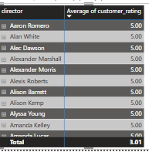
Business Decision-Making Scenarios
A total of more directors and cast members received an average rating of 5, indicating that multiple creators consistently delivered highly-rated content.
We can leverage popular cast members so, viewers may be more likely to watch content with familiar, well-liked actors.

Slide 13
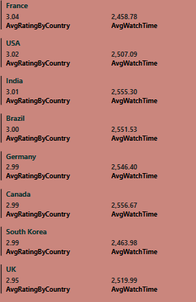
Content Localization Strategy
UK and South Korea have the lowest content availability (below 1000 titles).These regions also show low watch time and user ratings.
This suggests a possible content gap users may not find enough or suitable content to watch and rate highly.
STRATEGIES:
Increase the quantity of content and variety of content aligned with current preferences . Promote high-rated genres and most popular like Fantasy, Romance, and Drama in these countries.

Slide 14
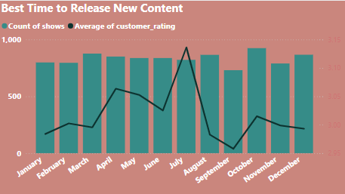
Best Time to Release New Content
Upon analyzing, July is the best month to release new content. It combines high content volume with the highest user satisfaction 3.14 average rating.
October has the highest content volume, but lower user ratings releasing more doesn’t mean users are happier.
Avoid high-volume drops in August and September unless content quality is improved.

Slide 15
Competitor Benchmarking Simulation
Content Availability by Country: France have the highest content availability and UK have comparatively lower content volume.
Average Rating by Country: Australia have the highest user satisfaction and UK show lower average ratings, despite Germany having high content volume.
High content volume doesn’t always mean high user satisfaction. Countries like Australia and Japan have better-rated content even with less quantity than France or India.
Recommendation:
Removing underperforming titles or improving recommendation algorithms.
Focus on quality, not just quantity
We can provide more content in Australia.
Avoid high-volume drops in August and September unless content quality is improved.

Slide 16
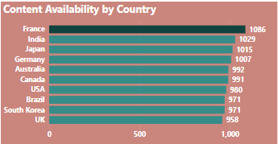
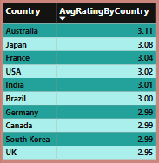
Charts: Content availability by country, average rating by country.

Slide 17
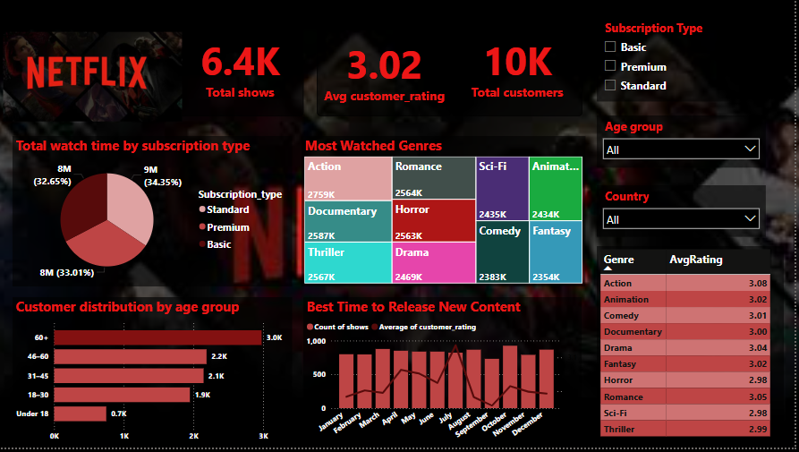
Customer Engagement Dashboard
Standard subscription plan has the highest user base and watch time, followed closely by Premium. Users aged 60+ are the most engaged, contributing the highest average watch time.
Action, Documentary, and Thriller are the most-watched genres across all user segments.TV Shows slightly outperform movies in total watch time, showing higher long-form engagement.
Recommendation: Improve engagement among younger users (under 30) with youth-focused ,trending content and Plan major content releases during July and April.

